Slide 1
K-Means Clustering
Sunday, 11/12/2017
a reproduced script using Python

Slide 2
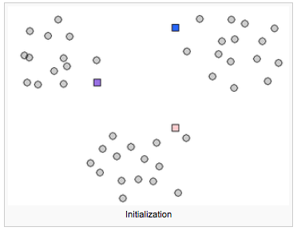
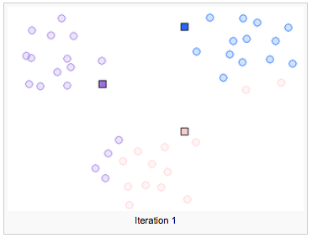
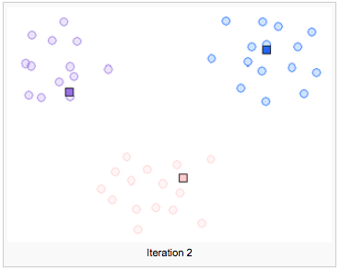
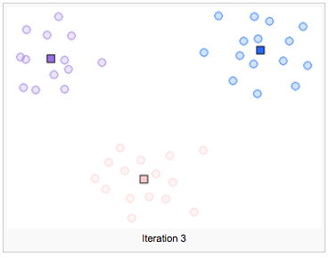
K-Means Algorithm
Sunday, 11/12/2017
Iterative steps:
Initialization: pick k cluster centroids at random
Alternate until convergence:
Assign examples to nearest centroid (cluster assignment)
Set centroid to be the mean of examples assigned to it (centroid assignment)
Notes:
In this case, “convergence” can describe the moment when an iterative computation of means for all clusters stay the same.

Slide 3



Objectives in Mathematical Expression
Sunday, 11/12/2017
K-Means Objective
To minimize the sum of distances of centroids to their cluster members:
Iterative steps when alternating:
Cluster assignment: Fixing centroids for each point i, assign it to the closest centroids
Centroid assignment: Fixing cluster members, centroids are set to be the means:
Notes:
In this case, “convergence” can describe the moment when an iterative computation of means for all clusters stay the same.

Slide 4
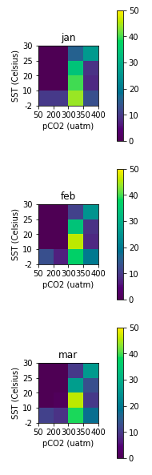
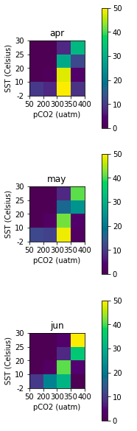
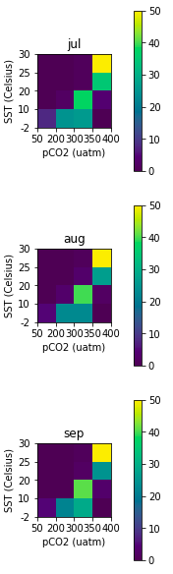
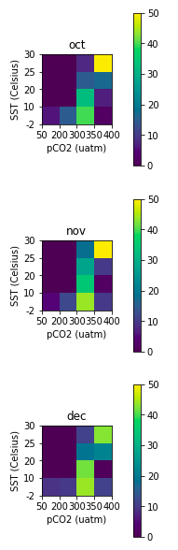
Classification Input: Monthly 2-D Histogram of SST/pCO2
Sunday, 10/29/2017

Slide 5
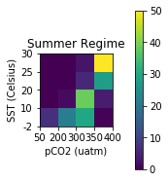
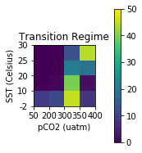
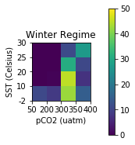
Reproduced K-Means Result
Sunday, 11/12/2017
Average months are classified into 3 clusters:
winter
summer
transitional
Jan
Feb
Mar
Apr
May
Jun
Jul
Aug
Sep
Oct
Nov
Dec
2-D Histograms with SST and pCO2 variables:
Notes:
In this case, “convergence” can describe the moment when an iterative computation of means for all clusters stay the same.

Slide 6
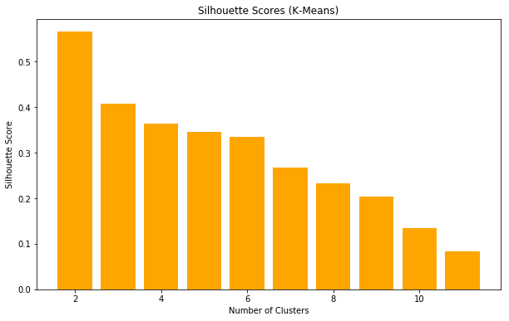
Silhouette Scores for selecting k
The silhouette scores suggests that an ideal number of clusters for k-means is 3.

Slide 7
Expectation-Maximization (EM) Algorithm
Sunday, 10/22/2017
a soft clustering approach for
ocean carbon regimes classification

Slide 8
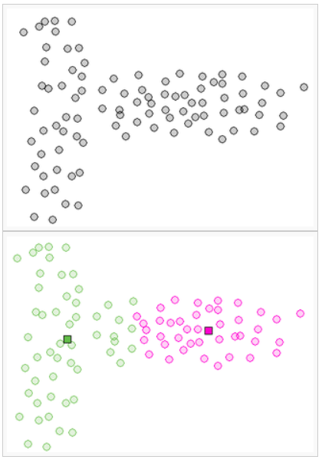
Drawbacks of K-Means
Sunday, 11/12/2017
Issue with K-Means in some situations:
K-means is a special clustering with mixture of Gaussians where all variances are equal, meaning its covariance is zero and mixture weights are equal (source: UPenn E-M Lecture)
Suboptimal performance due to its underlying assumption that clusters are spherical, which could cause a clustering assignment like one on the left.
Notes:
In this case, “convergence” can describe the moment when an iterative computation of means for all clusters stay the same.

Slide 9



Expectation-Maximization (EM)
Sunday, 11/12/2017
Alternative of K-Means:
A probabilistic approach to clustering is to assume that all data points are generated from the same distribution, that is, a set of k simple distributions: Gaussians
Instead of hard-assigning cluster members to 0 or 1, we use , the probability that a sample is drawn from k-th mixture component. And in the above first case, the following satisfies:
, similarly:
Notes:
In this case, “convergence” can describe the moment when an iterative computation of means for all clusters stay the same.

Slide 10


EM Objectives
Sunday, 11/12/2017
EM is a very general algorithm for learning models with hidden variables.
The goal is to maximize the marginal likelihood of data (with hidden variables summed out).
Thus, we estimate parameters of the mixture using maximum likelihood estimation (MLE) or maximum a priori (MAP), and find the argmax over of:
Notes:
In this case, “convergence” can describe the moment when an iterative computation of means for all clusters stay the same.

Slide 11
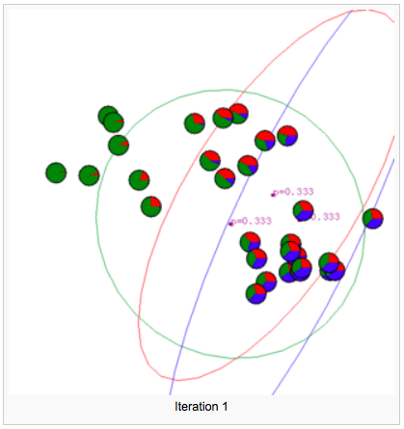
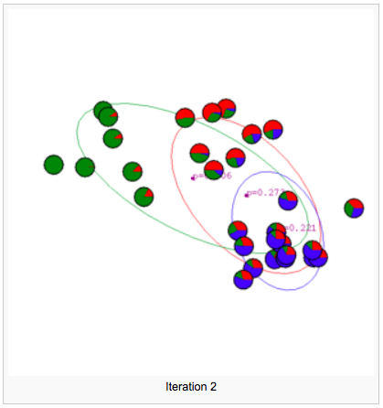
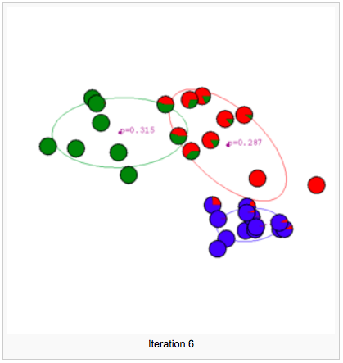
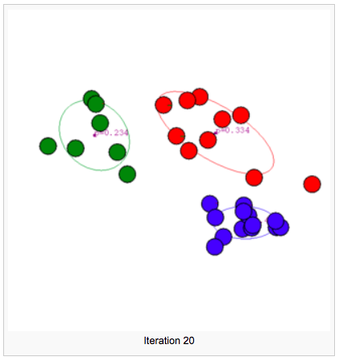
EM Algorithm
Sunday, 11/12/2017
Iterative steps:
Initialization: pick initial hidden variables for the Gaussians at random
Alternate until convergence:
E: Assign each data point to the cluster from which it most likely originated (estimate probability).
M: Update the Gaussian parameters with maximum likelihood estimates (update hidden variables).
Notes:
Some other helpful resources:
http://scikit-learn.org/stable/modules/mixture.html
http://mattdickenson.com/2016/06/06/expectation-maximization-gaussian/
http://scikit-learn.org/stable/modules/generated/sklearn.mixture.GaussianMixture.html

Slide 12





EM Algorithm in Mathematical Expression
Sunday, 11/12/2017
Iterative steps:
Initialization: pick at random
Alternate until convergence:
E: Estimate
M: Estimate the new hidden variables:

Slide 13

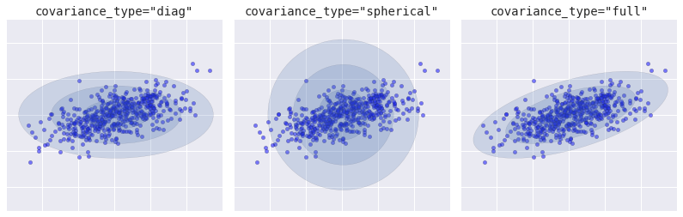
Variance Parameters
Sunday, 11/12/2017
Common choices in learning variances of EM Gaussian Mixtures:
Full: a is arbitrary (unknown) for each class. Clusters are ellipsoids, parameters.
Tied: is arbitrary but same for each class. All clusters have same ellipsoid shape, O(m2) pars.
Diagonal: is a diagonal matrix. Clusters are axis-aligned ellipsoids, O(Km) parameters.
Spherical: is . Clusters have spherical shape.
Notes:
Further reading: https://jakevdp.github.io/PythonDataScienceHandbook/05.12-gaussian-mixtures.html
MM Algorithms for Variance Components Models (https://arxiv.org/pdf/1509.07426.pdf)
Gaussian Mixture Models (https://www.ll.mit.edu/mission/cybersec/publications/publication-files/full_papers/0802_Reynolds_Biometrics-GMM.pdf)
Gaussian Mixture Models (http://scikit-learn.org/stable/modules/mixture.html)
GMM Covariances (http://scikit-learn.org/stable/auto_examples/mixture/plot_gmm_covariances.html#sphx-glr-auto-examples-mixture-plot-gmm-covariances-py)

Slide 14
EM v. K-Means
Sunday, 10/22/2017
EM Clustering:
soft assigns a data point to clusters, giving a probability of any points belonging to any centroid.
doesn't depend on the L2 norm, but is based on the Expectation, i.e., the probability of the point belonging to a particular cluster.
infinite number of configurations (doesn’t have to converge)
K-Means Clustering:
hard assigns a data point to one particular cluster on convergence, giving a class to any points either 0 or 1.
makes use of the L2 norm when minimizing {Theta} L2 norm point and its centroid coordinates.
limited number of configurations (converges after a large number of iterations)

Slide 15
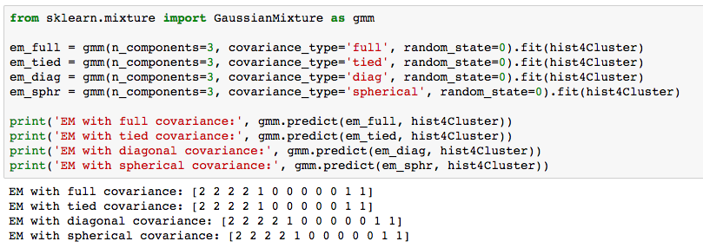
Python Implementation
Tuesday, 11/07/2017
Using different options to constrain the covariance of the difference classes estimated: spherical, diagonal, tied or full covariance.
It turns out that all types of covariances result in the same exact classification of the ocean carbon regimes.

Slide 16
EM Clusters Result
Sunday, 11/12/2017
Average months are classified into 3 clusters:
winter
summer
transitional
Jan
Feb
Mar
Apr
May
Jun
Jul
Aug
Sep
Oct
Nov
Dec
2-D Histograms with SST and pCO2 variables:
Equal to K-Means result!
Notes:
In this case, “convergence” can describe the moment when an iterative computation of means for all clusters stay the same.

Slide 17
Hierarchical / Agglomerative Clustering
Tuesday, 11/07/2017
an alternative approach for classifications

Slide 18
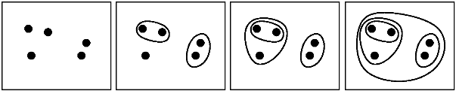
Agglomerative / Hierarchical Algorithm
Sunday, 11/12/2017
Iterative steps:
Initialization: define each data point to be a cluster
Combine existing clusters at each step. Three methods for doing this:
Ward linkage
Average linkage
Complete linkage
Notes:
Some other helpful resources:
https://onlinecourses.science.psu.edu/stat505/node/143

Slide 19
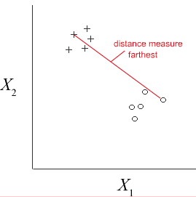
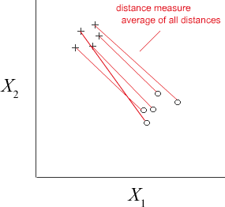
Different Linkage Methods
Sunday, 11/12/2017
Complete linkage:
The distance between two clusters is the maximum distance between any single data point in the first cluster & any single data point in the second cluster.
At each stage, combine the two clusters that have the smallest complete linkage distance.
Average linkage:
The distance between two clusters to be the average distance between data points in the first cluster and data points in the second cluster.
At each stage, combine the two clusters that have the smallest average linkage distance.
complete linkage
average linkage
Notes:
Some other helpful resources:
https://onlinecourses.science.psu.edu/stat505/node/143

Slide 20

Different Linkage Methods
Sunday, 11/12/2017
Ward method:
ANOVA-based approach: Does not directly define a measure of distance between two points or clusters. Rather, it minimizes the variance of the clusters being merged.
Ward's minimum variance criterion also minimizes the total within-cluster variance.
Although it is not distance that’s being optimized, the initial distance between individual objects during implementation of Ward’s method must be proportional to squared Euclidean distance:
At each stage, when the two clusters merge, it provides the smallest increase in the combined error sum of squares from one-way univariate ANOVAs. This is done for each variable in the clusters.
Notes:
Some other helpful resources:
https://en.wikipedia.org/wiki/Ward%27s_method
http://scikit-learn.org/stable/modules/generated/sklearn.cluster.AgglomerativeClustering.html (default on sklearn)

Slide 21
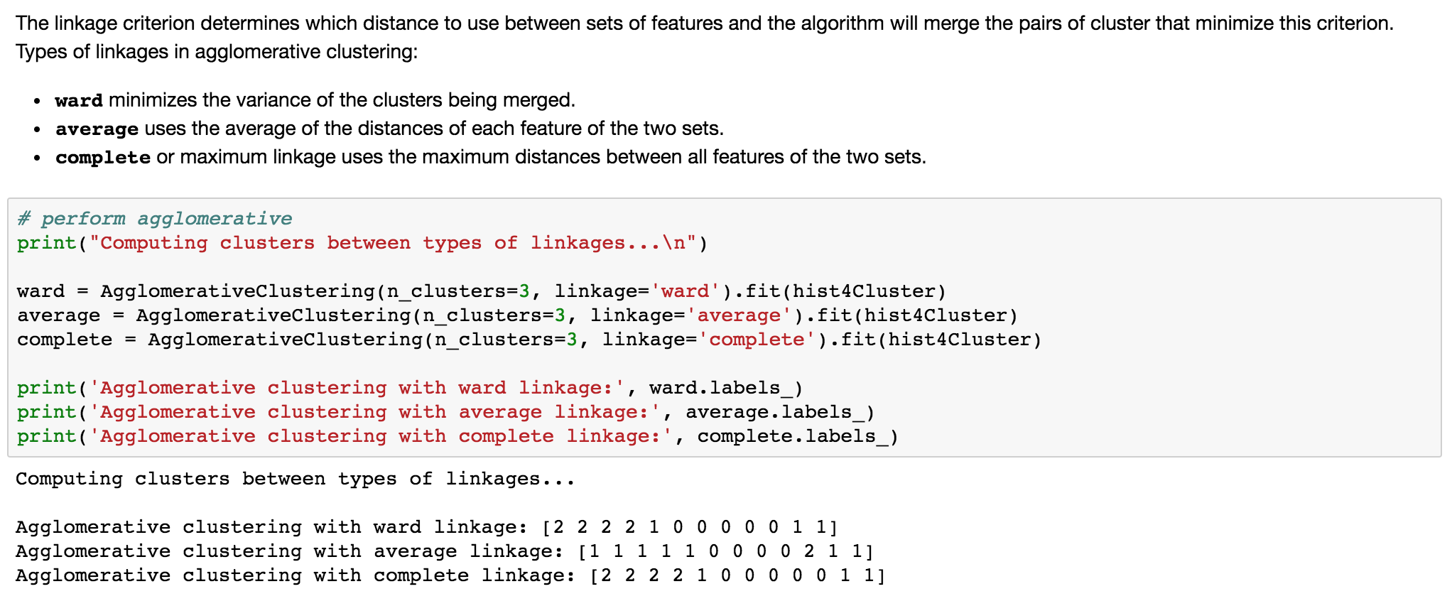
Python Implementation
Tuesday, 11/07/2017
The hierarchical clustering using ward and complete linkages give the same classification results as k-means, but average linkages are quite different.
Notes:
Sample of implementation: http://www.cs.princeton.edu/courses/archive/spring10/cos233/lectures/cos233-234-lecture7.pdf
How to explain hierarchical clustering: http://www.analytictech.com/networks/hiclus.htm
https://home.deib.polimi.it/matteucc/Clustering/tutorial_html/hierarchical.html

Slide 22
Agglomerative / Hierarchical Clusters Result
Tuesday, 11/07/2017
Average months are classified into 3 clusters:
winter
summer
transitional
Jan
Feb
Mar
Apr
May
Jun
Jul
Aug
Sep
Oct
Nov
Dec
Agglomerative ward
Jan
Feb
Mar
Apr
May
Jun
Jul
Aug
Sep
Oct
Nov
Dec
Agglomerative average
Jan
Feb
Mar
Apr
May
Jun
Jul
Aug
Sep
Oct
Nov
Dec
Agglomerative linkage
Notes:
Becca’s paper mentioned that Winter includes December through April, then summer includes July through November, with June as the only transitional.
May wasn’t stated

Slide 23
Regimes Classification by Models
Sunday, 11/12/2017
Comparison between k-means, EM, and agglomerative clustering

Slide 24
All Model Results
Tuesday, 11/07/2017
winter
summer
transitional
Jan
Feb
Mar
Apr
May
Jun
Jul
Aug
Sep
Oct
Nov
Dec
Becca’s k-means
Jan
Feb
Mar
Apr
May
Jun
Jul
Aug
Sep
Oct
Nov
Dec
reproduced k-means
Jan
Feb
Mar
Apr
May
Jun
Jul
Aug
Sep
Oct
Nov
Dec
E-M full
Jan
Feb
Mar
Apr
May
Jun
Jul
Aug
Sep
Oct
Nov
Dec
E-M tied
Jan
Feb
Mar
Apr
May
Jun
Jul
Aug
Sep
Oct
Nov
Dec
E-M diagonal
Jan
Feb
Mar
Apr
May
Jun
Jul
Aug
Sep
Oct
Nov
Dec
E-M spherical
Jan
Feb
Mar
Apr
May
Jun
Jul
Aug
Sep
Oct
Nov
Dec
Agglomerative ward
Jan
Feb
Mar
Apr
May
Jun
Jul
Aug
Sep
Oct
Nov
Dec
Agglomerative average
Jan
Feb
Mar
Apr
May
Jun
Jul
Aug
Sep
Oct
Nov
Dec
Agglomerative linkage
Notes:
Becca’s paper mentioned that Winter includes December through April, then summer includes July through November, with June as the only transitional.
May wasn’t stated

Slide 25
Conclusion
Tuesday, 11/07/2017
Most consistent result:
winter: January, February, March, April
transitional: May, November, December
summer: June, July, August, September, October
Obtained by all models but agglomerative clustering with average linkage, which gives longest winter months (November through May), one transitional period (October), and the remaining is summer months (July through September)

